Slide 1
January 31, 2022
OCT Business Operations Dashboard
Owner
The Data Squad, Tech Financial Ops Team, Louis A. Boney, Ryan Nishimoto

Slide 2


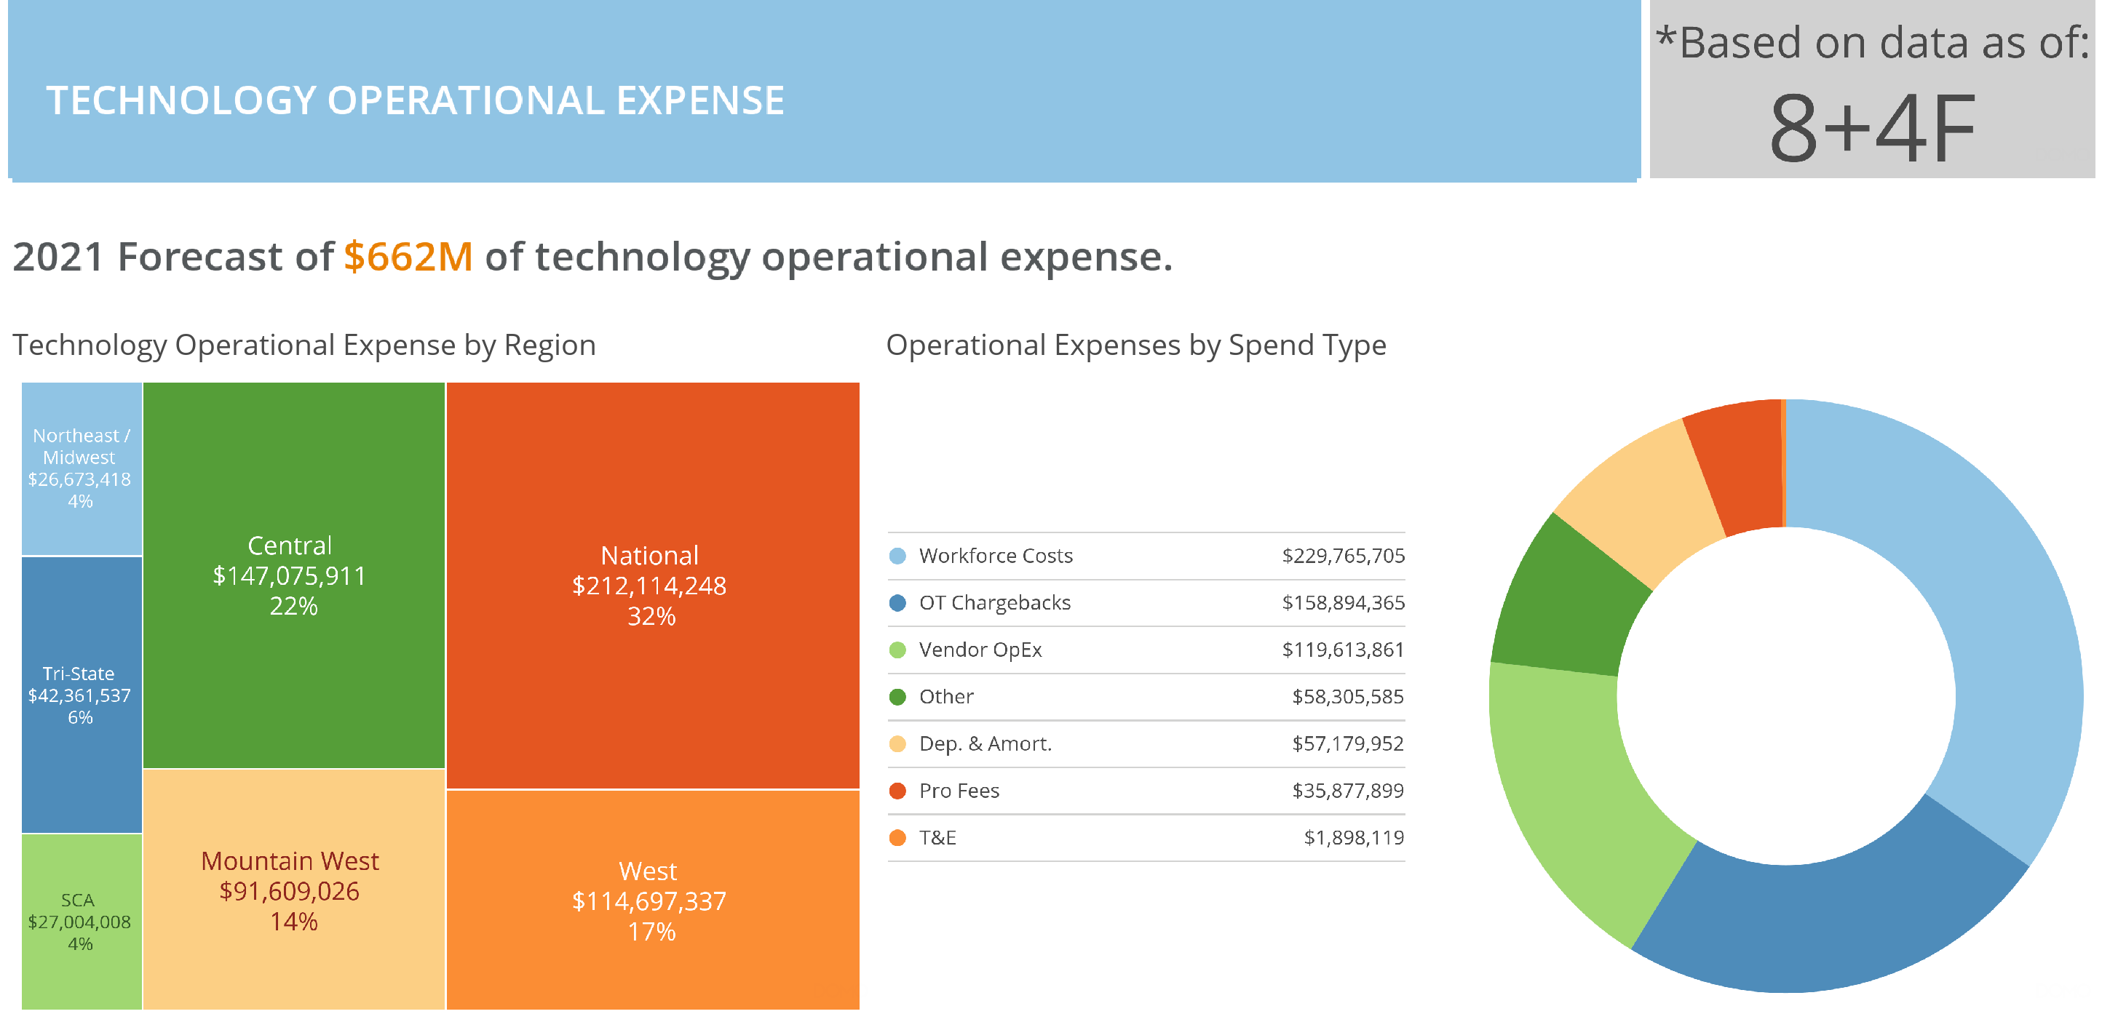

Slide 3
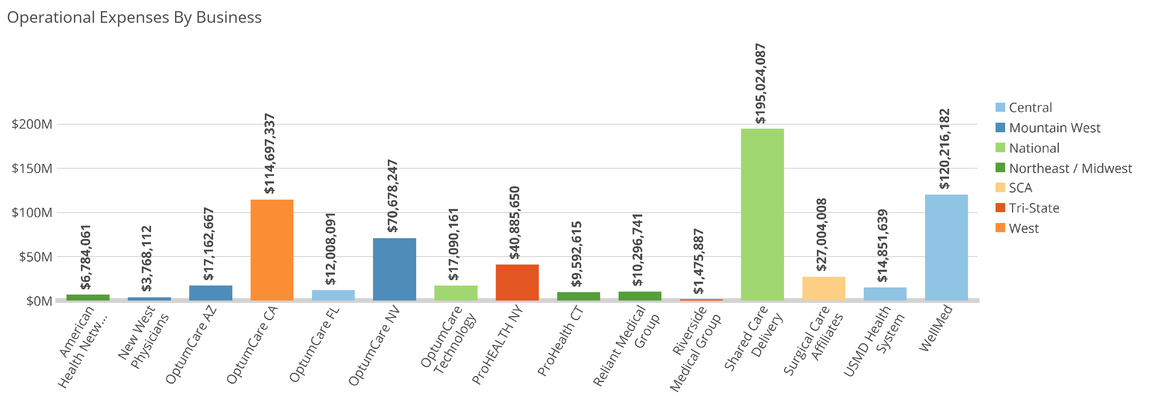

Slide 4
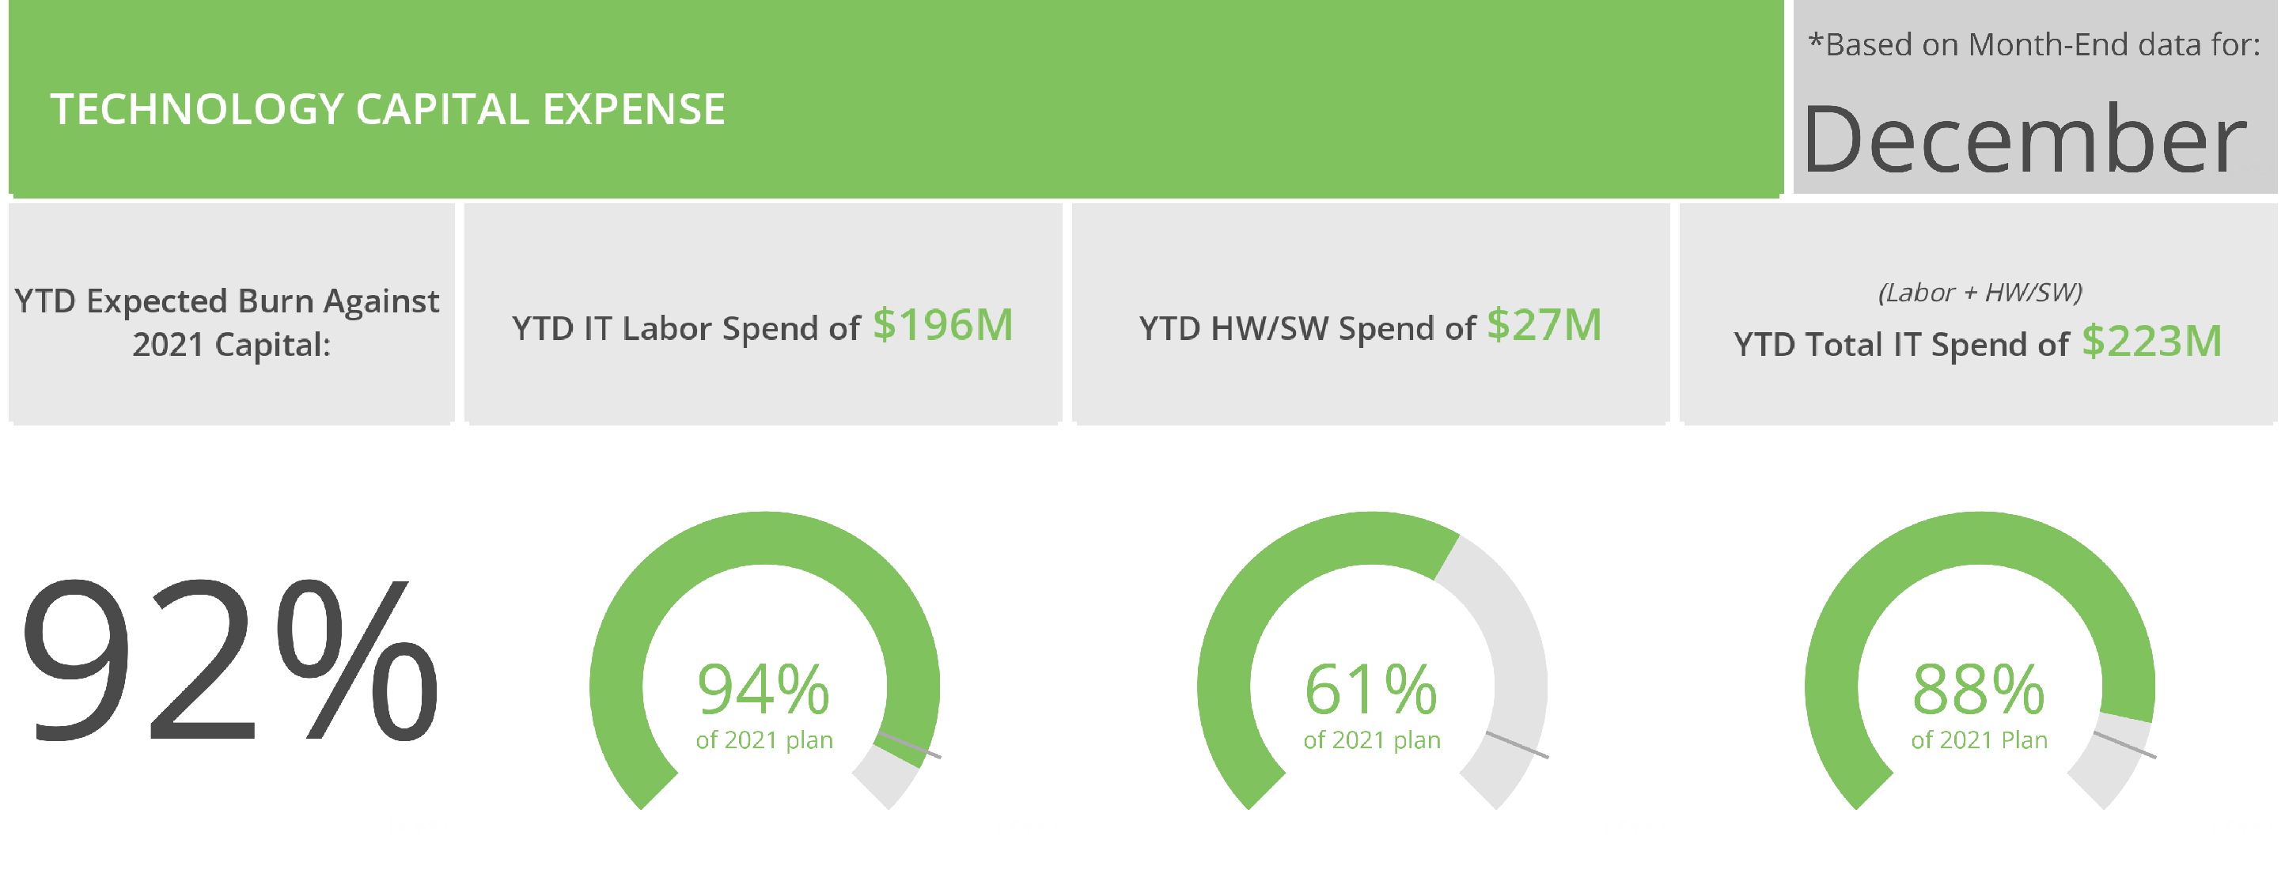

Slide 5
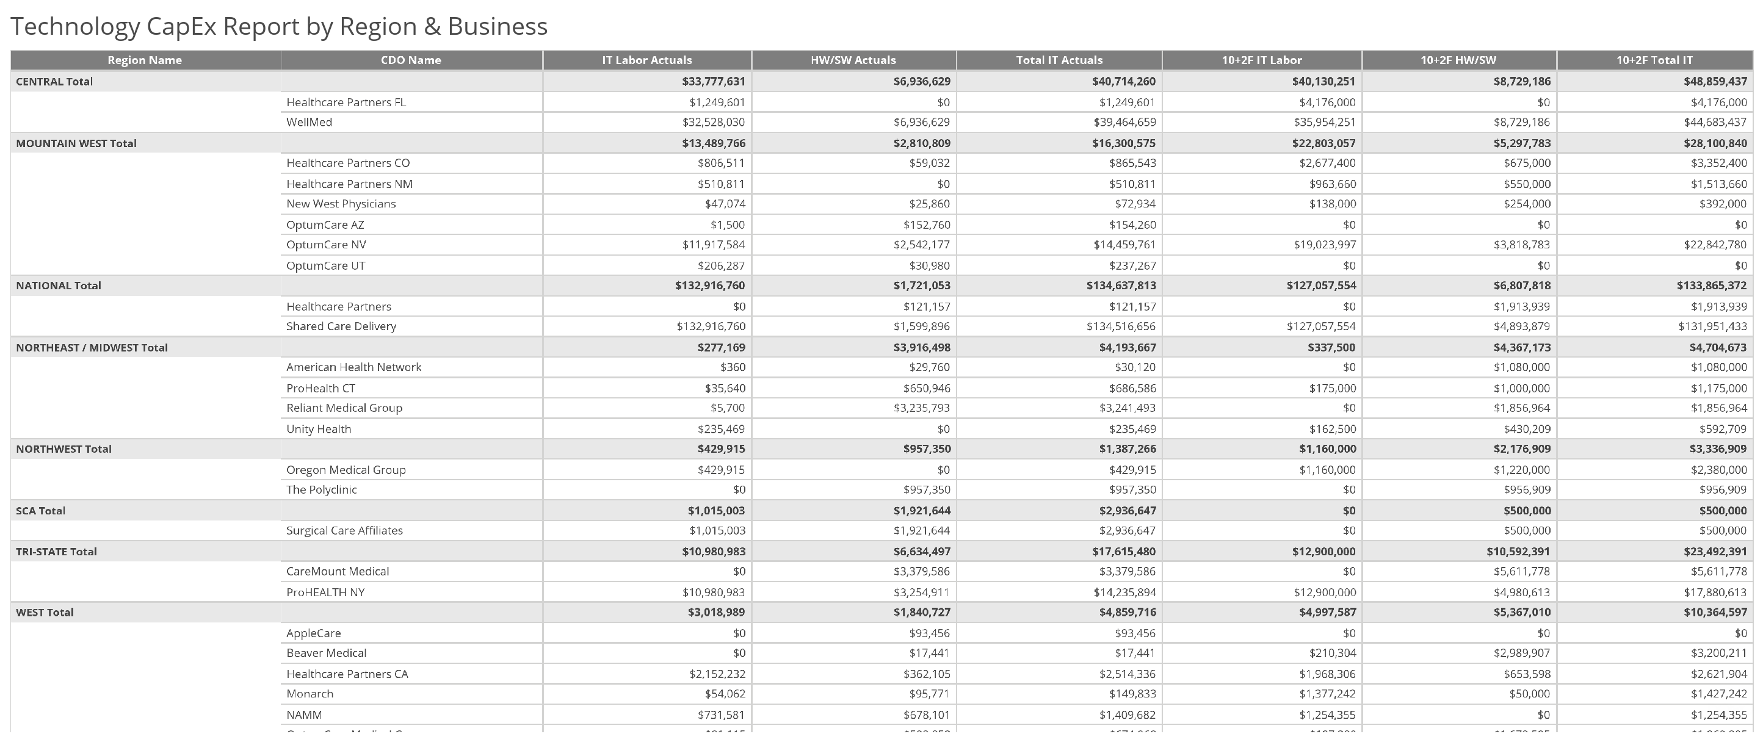

Slide 6
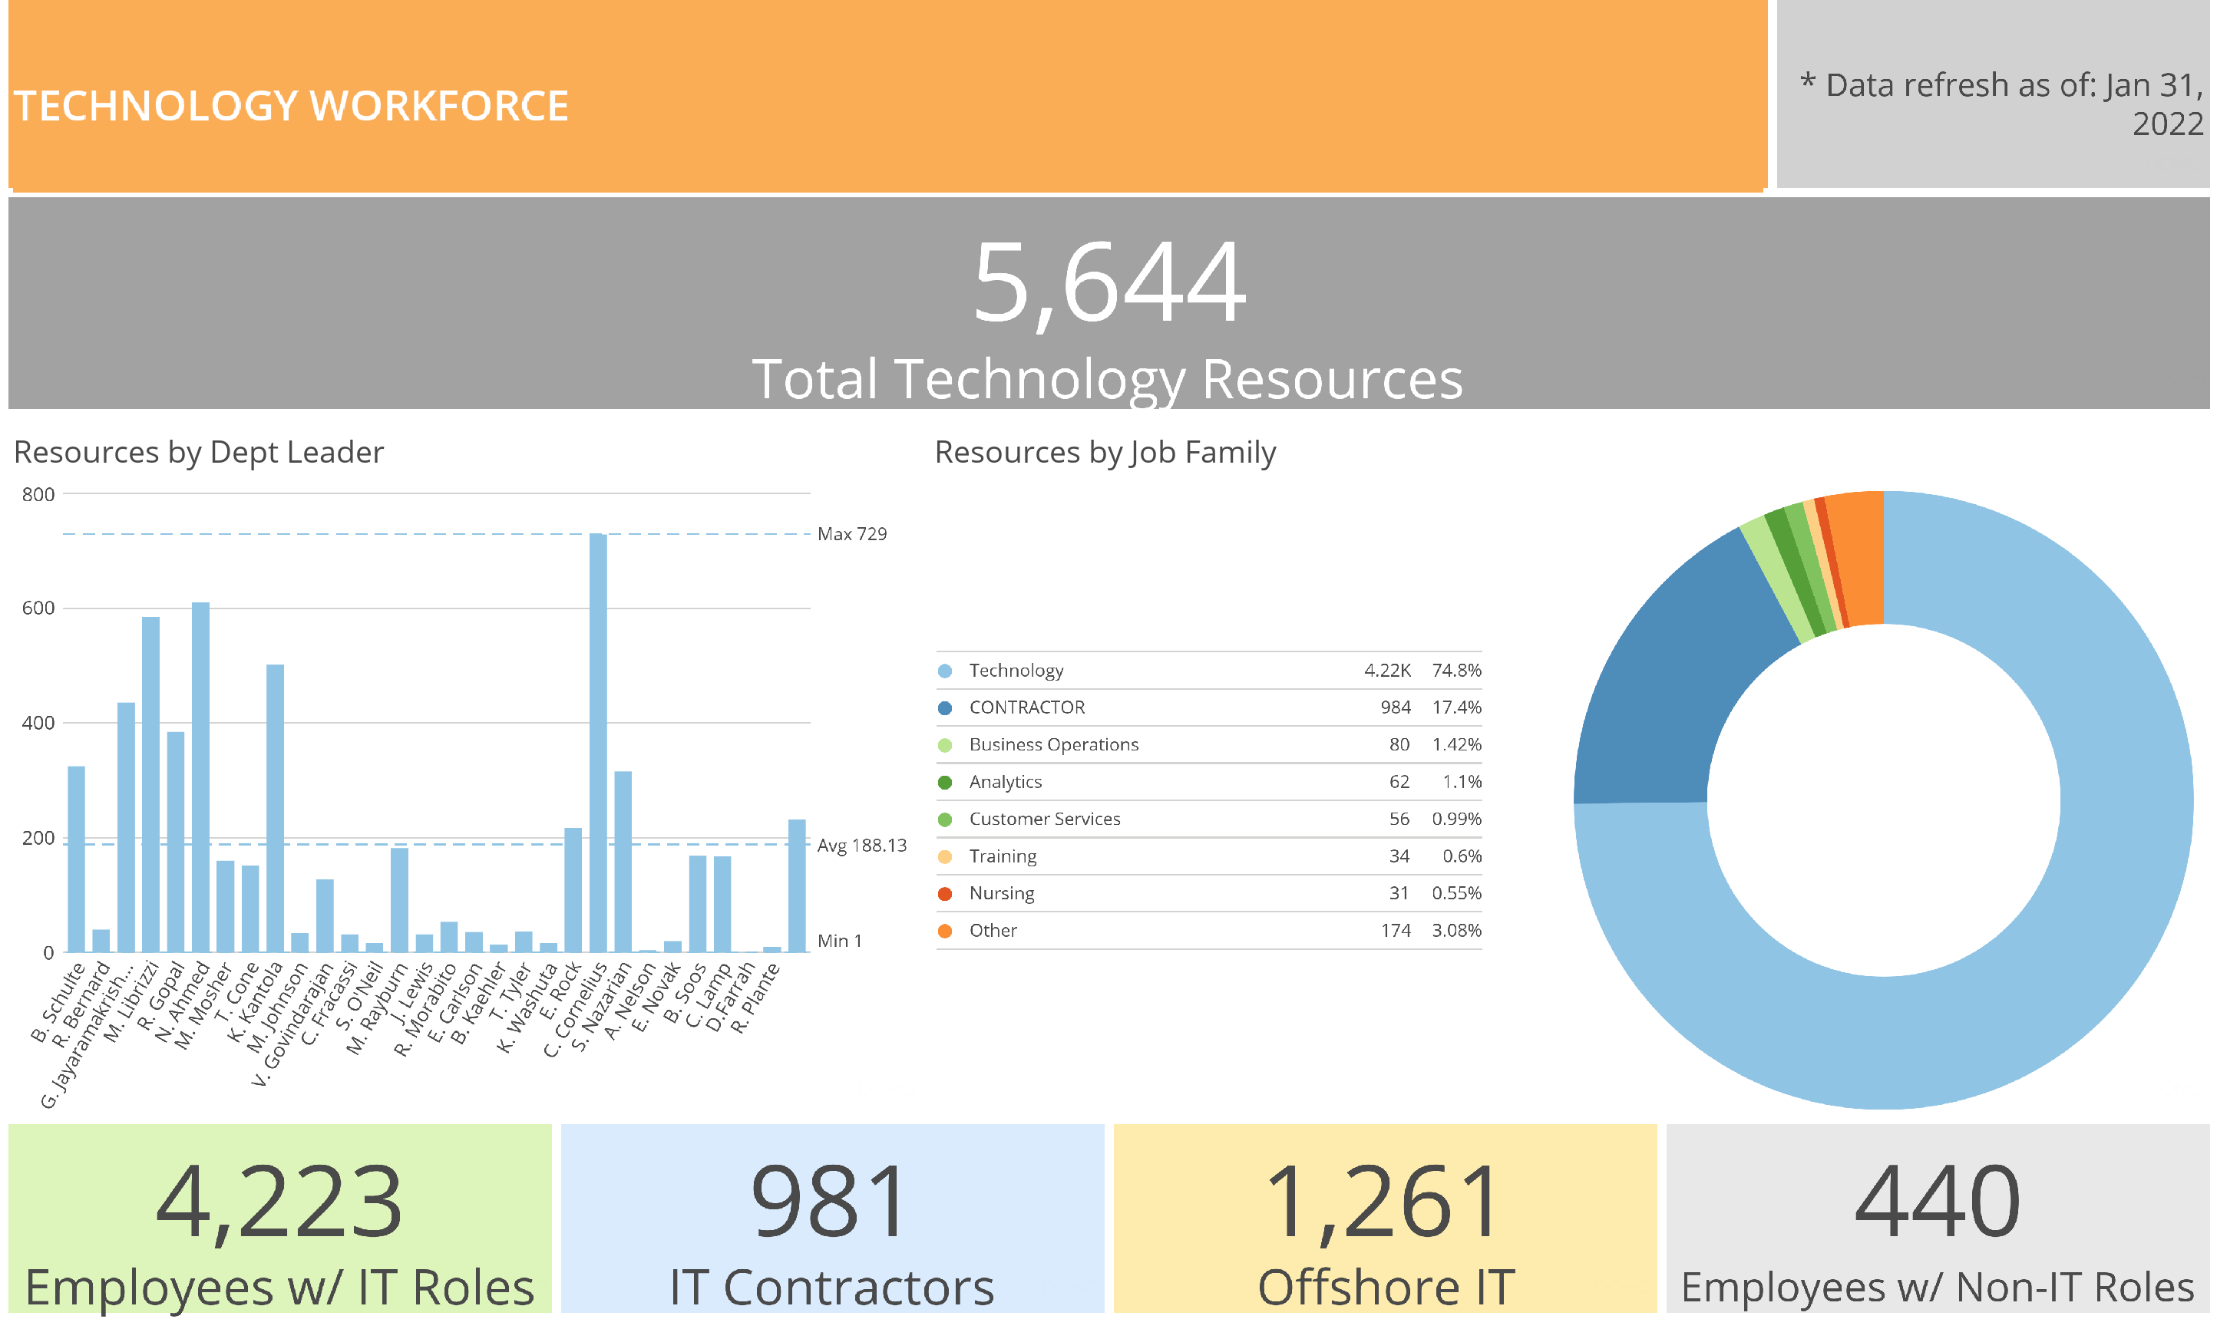

Slide 7
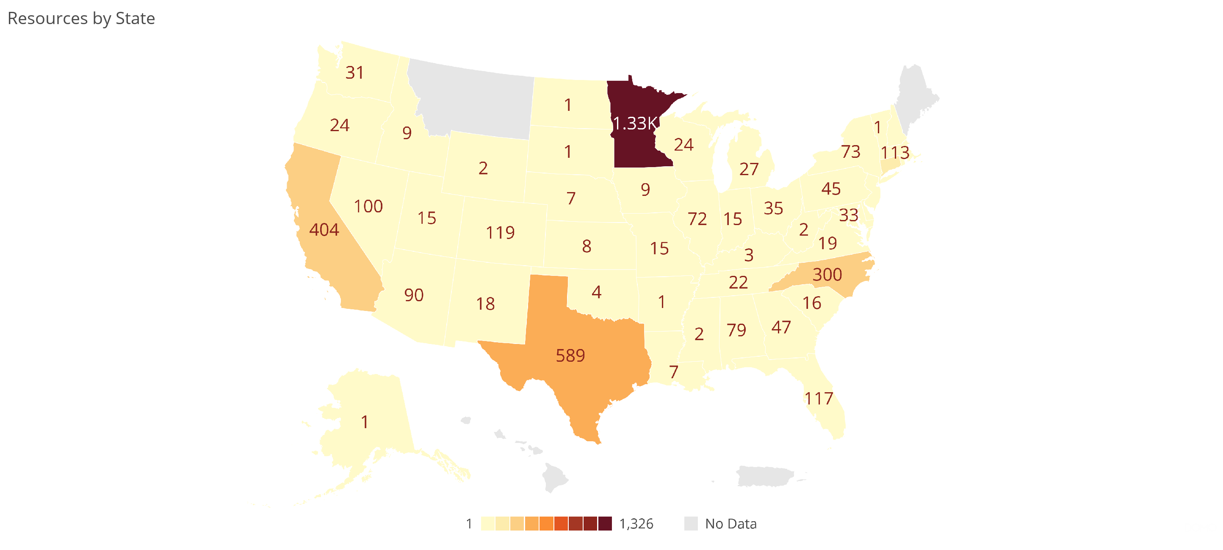

Slide 8
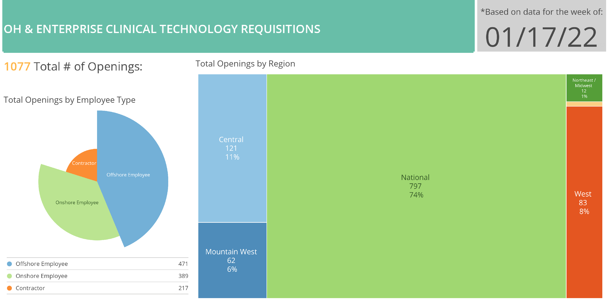

Slide 9
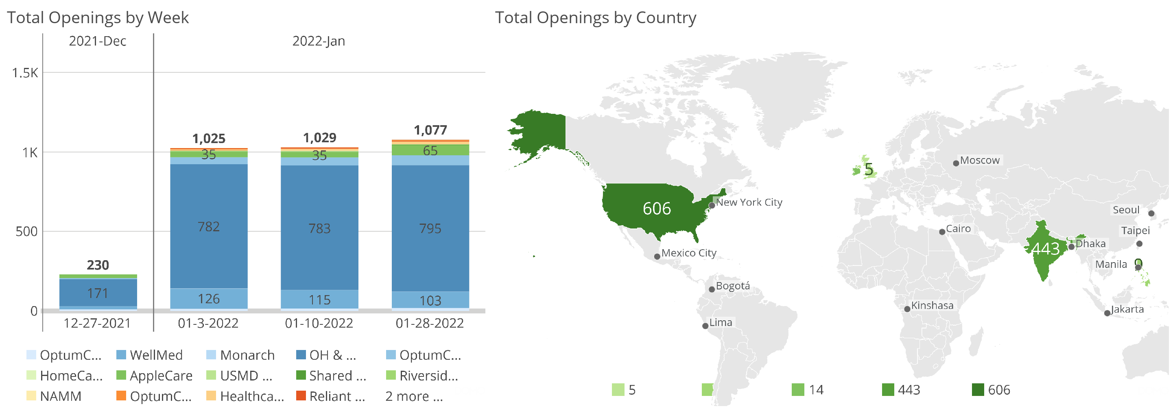

Slide 10
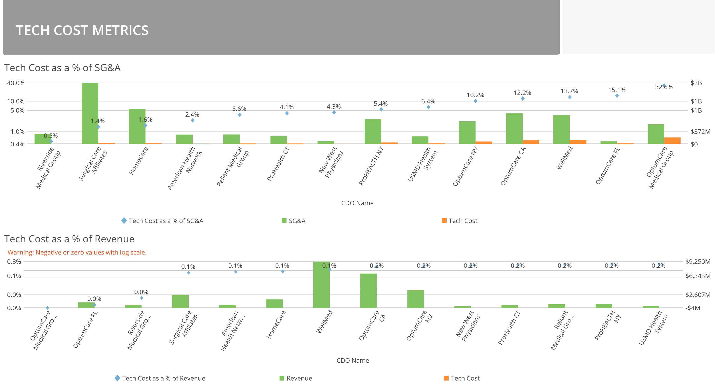

Slide 11


Slide 12

Appendix

